Slide 1
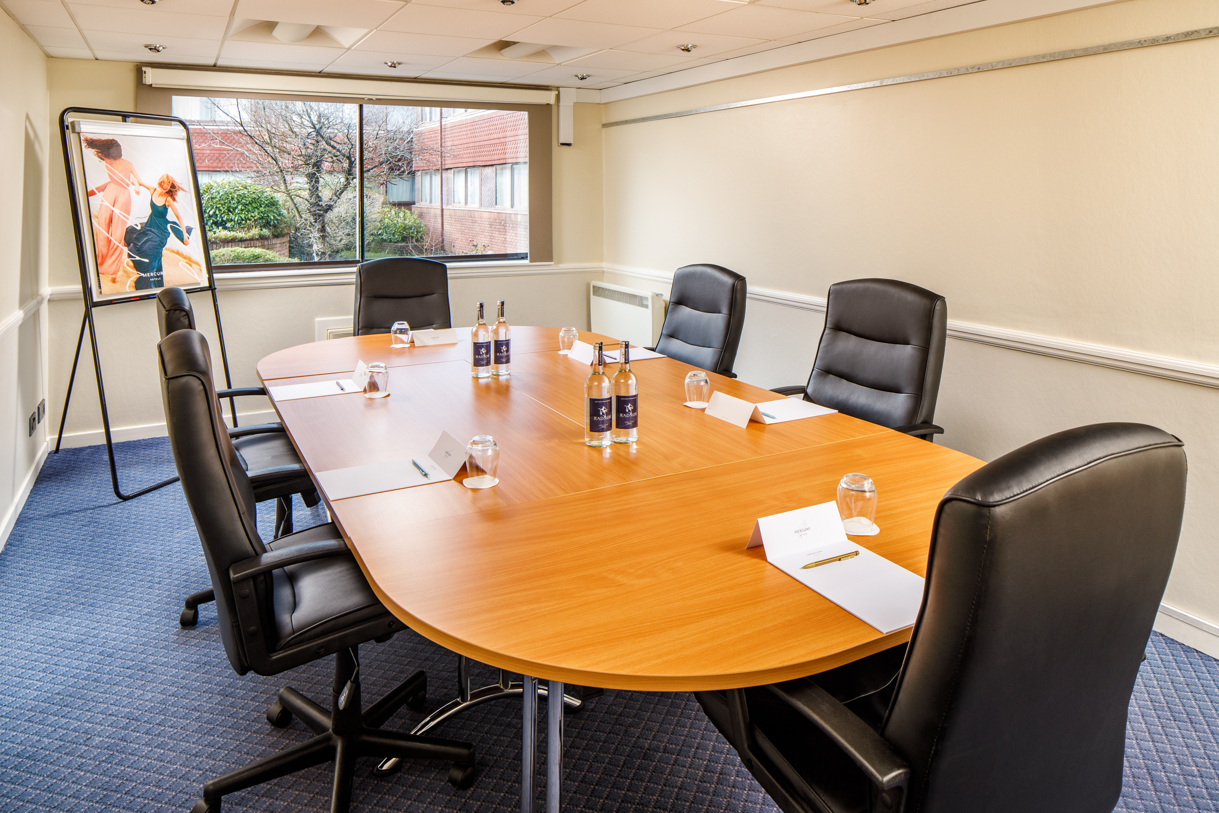
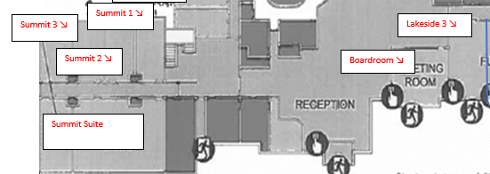

SUMMIT ROOMS 1, 2 & 3
Summit 1, 2 and 3 are ideally located on the ground floor, opposite our Summit Suite. They make great syndicate rooms
or small meeting rooms for those important get togethers.
Key Information
Floor | Ground
Disabled access | Yes
Natural Daylight | Yes
Air Conditioning | No
Setup | Capacity
Theatre (each) | 14
Boardroom (each) | 10
Dinner (each) | 10
Room Dimensions
Length & Width | 6.12m x 3.44m
Square Metres | 21.05

